Slide 1



Slide 2

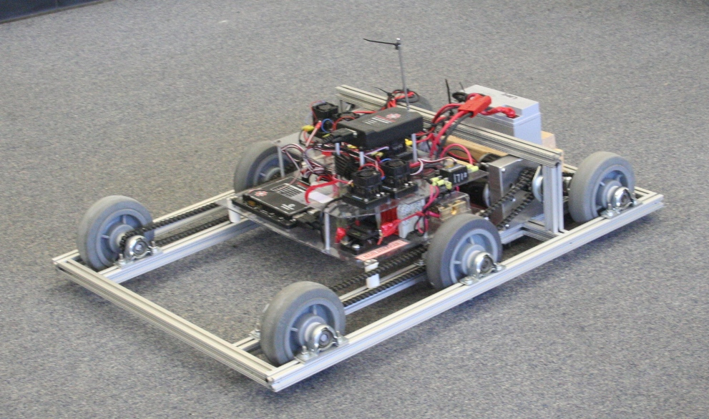
Importance
Basics
Drive Types
Resources
Traction
Mobility
Speed
Timing
Importance

Slide 3
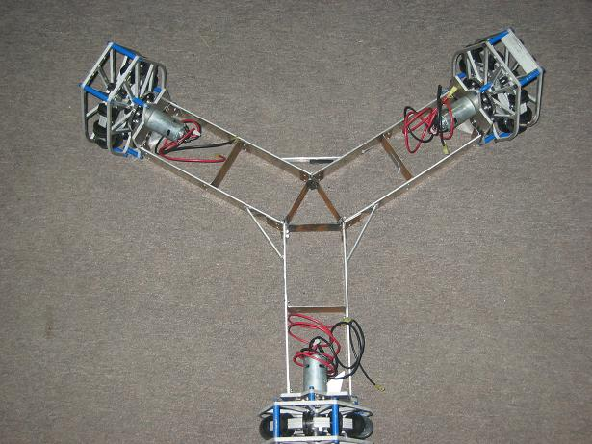

The best drive train…
is more important than anything else on the robot
meets your strategy goals
can be built with your resources
rarely needs maintenance
can be fixed within 4 minutes
is more important than anything else on the robot

Slide 4

Know your resources
Decide after kickoff:
  Speed, power, shifting, mobility
Use most powerful motors on drivetrain
Don’t drive ½ of your robot… WEIGH IT DOWN!
Break it early
Give software team TIME to work
Give drivers TIME to drive

Slide 5

DrivenWheel
Motor(s)
Motor(s)
+ Easy to design
+ Easy to build
+ Light weight
+ Inexpensive
+ Agile
Not much power
Will not do well on ramps
Less able to hold position
Caster

Slide 6

DrivenWheels
Motor(s)
Motor(s)
Chain or belt
+ Easy to design
+ Easy to build
+ Inexpensive
+ Powerful
+ Sturdy and stable
Not agile
  Turning is difficult
  Adjustments needed
Resource:
Chris Hibner white paper on ChiefDelphi.com
Proves that a wide 4wd drive base can turn easily
DrivenWheels

Slide 7

DrivenWheels
Motor(s)
Motor(s)
+ Easy to design
+ Easy to build
+ Powerful
+ Sturdy and stable
+ Many options
Mecanum, traction
Heavy
Costly
DrivenWheels
Motor(s)
Motor(s)

Slide 8

+ Easy to design
+ Easy to build
+ Powerful
+ Stable
+ Agile*
*2 ways to be agile
Lower contact point on center wheel
Omni wheels on front or back or both
This is the GOLD STANDARD in FRC
+ simple
+ easy
+ fast and powerful
+ agile
Gearbox
Gearbox
Heavy **
Expensive **
** - depending on wheel type

Slide 9

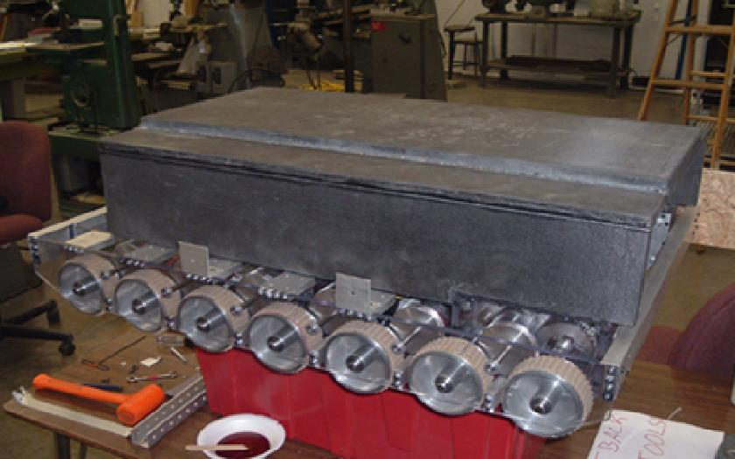
+ Powerful
+ Stable
+ Agile*
Sole benefit: Ability to go over things
Gearbox
Gearbox
HEAVY
EXPENSIVE
*2 ways to be agile
Lower contact point on center wheel
Omni wheels on front or back or both

Slide 10

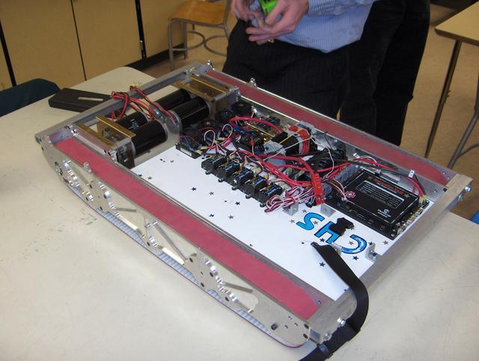
Gearbox
Gearbox
+ Powerful
+ VERY Stable
NOT AGILE
HEAVY
Inefficient
EXPENSIVE
Hard to maintain
Sole benefit: Ability to go over things
For turning, lower the contact point on center of track wheel
Will NOT push more than a well-controlled 6wd

Slide 11

Various types
Lightweight
Fast
Non-standard
  (design intensive)
Examples:
  16 in 2008
  67 in 2005
Gearbox
Gearbox

Slide 12

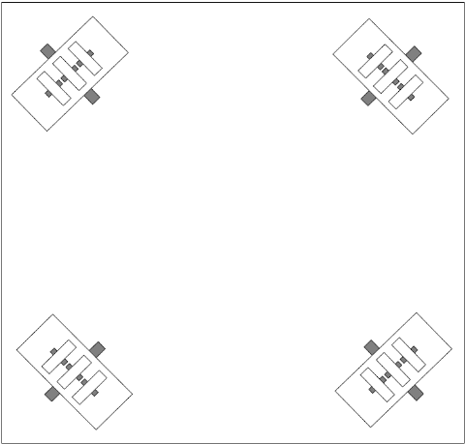
4 wheel drive or 3 wheel drive
Stephen Killough, 1994
+ Simple Mechanics
+ Immediate Turning
+ Simple Control – 4 wheel independent
No brake
Minimal pushing power
Jittery ride, unless w/ dualies
Incline difficulty

Slide 13

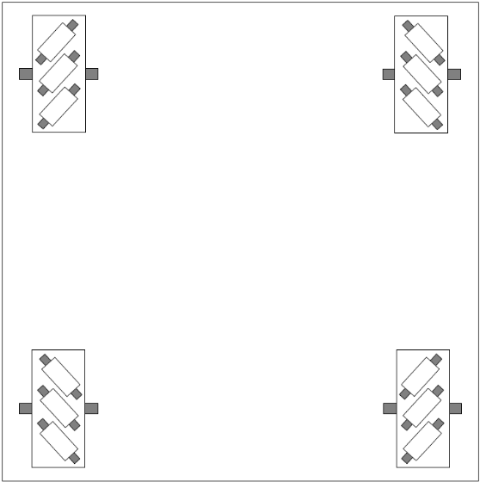
+ Simple mechanisms
+ Immediate turn
+ Simple control – 4 wheel independent
Minimal brake
OK pushing power
Needs a suspension
Difficulty on inclines

Slide 14

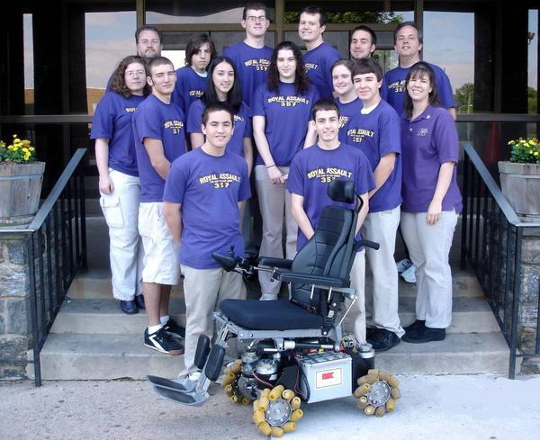

Slide 15

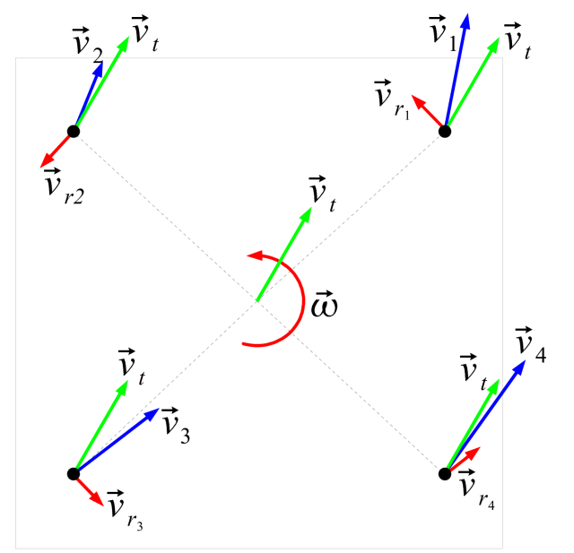
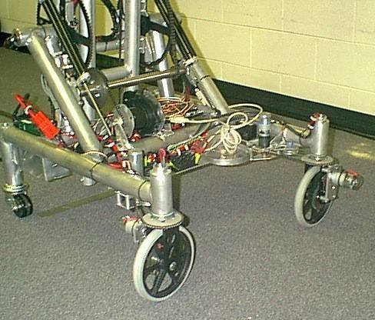
High-traction wheels
Each wheel rotates to steer
+ No friction losses in wheel-floor interface
+ Ability to push or hold position
+ Simple wheels
Complex system to control and program
Mechanical and control issues
Difficult to drive
Wheel turning delay
Omnidirectional drive systems presentation: http://first.wpi.edu/Workshops/2008CON.html

Slide 16

Design
  Difficult: swerve
Machining
  Difficult: swerve
  Moderate: non-kit frame
Money
  Kit wheels have been cheap
Time
  6 weeks, long hours, multiple shifts?

Slide 17

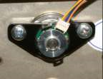
Static vs Dynamic (←10% lower)
  Once you slip, you will get pushed
  Design encoders into your system
  Dynamic breaking & traction control
Pushing force = Weight * μ
  μ = friction coefficient
Normal Force (weight)
Pushing Force
Static friction coefficients
μ = 0.1 = caster (free spinning)
μ = 0.3 = hard plastic
μ = 0.8 = smooth rubber, 80A durometer
= 1.0 = sticky rubber, 70A durometer
= 1.1 = conveyor treads

Slide 18

You can determine μ
mass
Fpull
Material w/ μ
Fweight
μ = Fpull / Fweight

Slide 19

Move +/- 1 foot in any direction in under 1 second
Generally speaking, the more mobile your robot is, the less it can resist a push
More mobile less mobile
Killough
4wd long
Mecanum
Swerve
4wd wide
6+ wheel
Tank Treads

Slide 20

Robot mass is represented at one point
Mobility increases when Cg is low and centered
High parts = light weight
Low parts = heavy (within reason
Battery motors pump, etc.
Ms Mobile
Battery motors pump, etc.
Mr Tippy

Slide 21

Game dependent, however… this increases every year
2008 max: 20 ft/sec
Controllable top speed: 15 ft/sec
Average 1-speed rate: 9 ft/sec
Good pushing speed: 5 ft/sec
Worksheet example

Slide 22

Get something driving early
  End of week 2
  Practice for operators
  Lessons learned for electrical
  Strategy lessons
Continuously improve
  Good enough is not good enough
Finish final drivetrain by week 4

Slide 23
Boat anchor = any heavy mass that does not move
A non-reliable or non-repairable drive base will turn your robot into a boat anchor
Good drive bases win consistently
Reliable drive bases win awards
Well-controlled, robust drive bases win Championships

Slide 24

Ken Patton and Paul Copioli
  Robot Drive System Fundamentals
  http://first.wpi.edu/Images/CMS/First/2007CON_Drive_Systems_Copioli.pdf
Ian Mackenzie and Andy Baker
  Omni Directional drive trains
  http://first.wpi.edu/Workshops/2008CON.htm

